Slide 1

Revolutionizing Gaming with Deep Learning: Autonomous Driving in GTA 5
Kartikay Kaul
S.R.Umapriya

Slide 2
Introduction
The project aims to implement the powerful Google Inception V3 model within the immersive world of GTA 5 to revolutionize the gaming experience.
Background: The Inception V3 model is renowned for its exceptional image recognition and classification abilities.
Dataset: A comprehensive dataset extracted from the dynamic game environment of GTA 5 is used to train the model on various driving scenarios, terrains, weather conditions, and traffic situations.

Slide 3
Related Work
"End-to-end Learning for Self-Driving Cars in GTA V" by M. Klinger, A. Mehta, and A. von Haeseler.
Supervised learning and reinforcement learning techniques are combined to train the self-driving car agent.
The approach is evaluated on various driving tasks within the GTA V game environment.
"DeepDriving: Learning Affordance for Direct Perception in Autonomous Driving" by C. Chen, A. Seff, A. Kornhauser, and J. Xiao.
A deep neural network is trained to estimate the affordance of drivable areas and road boundaries from raw sensor data.
The system is evaluated in a modified version of GTA V as a virtual testing environment.
"Virtual to Real Reinforcement Learning for Autonomous Driving" by Y. Pan, C. You, J. Wang, and X. Lu.
The paper proposes a virtual to real reinforcement learning framework.
Performance evaluation is conducted on a physical autonomous driving platform.
Inception V3: A deep convolutional neural network architecture for computer vision tasks with improved efficiency and performance.

Slide 4
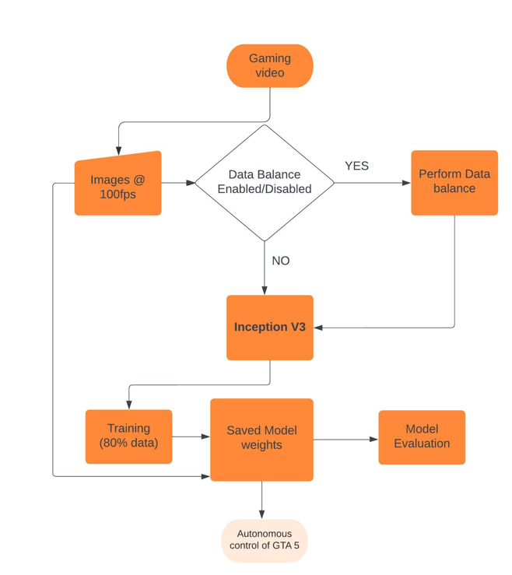
Implementation - Overview

Slide 5
Data Collection
The grab_screen.py script captures screenshots using the win32gui library in Windows.
It retrieves the screen dimensions, creates a device context and bitmap, copies screen pixels, and converts them into a numpy array using OpenCV.
The collect_data.py script captures screen frames, processes them, and collects training data.
Screenshots are converted to grayscale and resized to 160x120 pixels using OpenCV.
Key inputs are checked and converted into a one-hot array representing specific actions.

Slide 6
Data Collection
Key combinations are mapped to output labels:
A' + 'W' keys: Move left and forward [0 1 0 0 0].
'D' + 'W' keys: Move right and forward [0 0 1 0 0].
'S' key: Move backward [0 0 0 1 0].
Only 'W' key: Move forward [1 0 0 0 0].
No keys pressed: Do nothing [0 0 0 0 1].

Slide 7
Data Collection
The key_check function monitors and captures the state of specific keys using wapi.GetAsyncKeyState() for a predefined set of keys in real-time.
Captured screens and corresponding output labels are appended to the images and labels lists.
The dataset is saved to disk when the number of frames reaches a multiple of 500
The 'T' key can be used to pause and resume data collection.

Slide 8
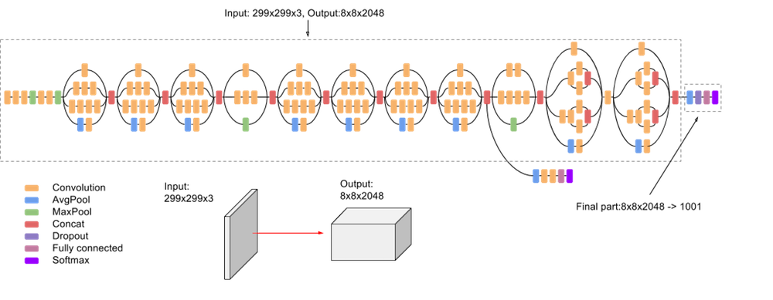
Model
First convolution layer is accommodate for grayscale input tensor of size (120,160)
From Inception V3 paper

Slide 9
Model
Model Architecture and Initialization:
init_weights=False to avoid pretrained weight initialization.
num_classes parameter specifies the number of output classes.
Adjusted the first convolutional layer (Conv2d_1a_3x3) to accept grayscale images.
Changed the number of input channels from 3 to 1 using a new nn.Conv2d layer.
Adapted the final fully connected layer (fc) to match the specified number of output classes.
Input x unsqueezed to add a channel dimension for grayscale images.
Input and weights converted to torch.float32 type for consistency.
Modified InceptionV3 model applied to the input, and the output is returned.

Slide 10
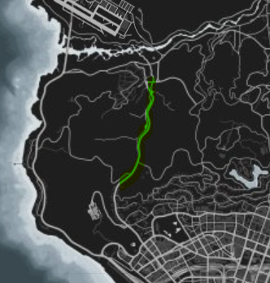
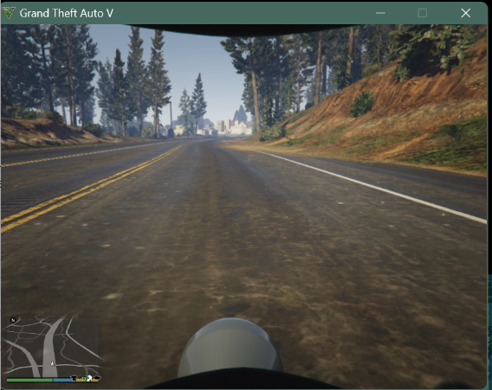

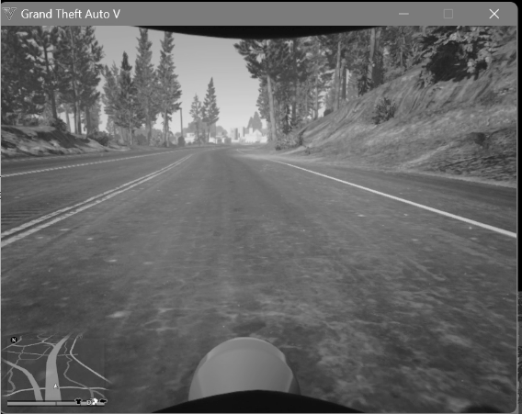
Radar route highlight
[0 0 0 1 0]
MODEL
Loss calculation
(800,600)
(160,120)
Training Flow
Update weights
Minibatch optimization
Test accuracy calculated at the end
At the final epoch, weights saved in disk.

Slide 11
Demonstration
The scenario faces several issues that will be presented in the next clip.
Whenever the AI gets stuck or person falls off the vehicle. We pause, reset and continue.
The model has a tendency to perform bad when the vehicle reaches high speeds. Small input feeds of reverse, left or right do not seem to influence it on high speed.
One improvement can be made to release w key input but a more complex branching statement or loop can be constructed to accommodate for that.
Also we can add thresholding in the key presses/releases to drop the speed or make the influence of slowing / turns more relevant.

Slide 12
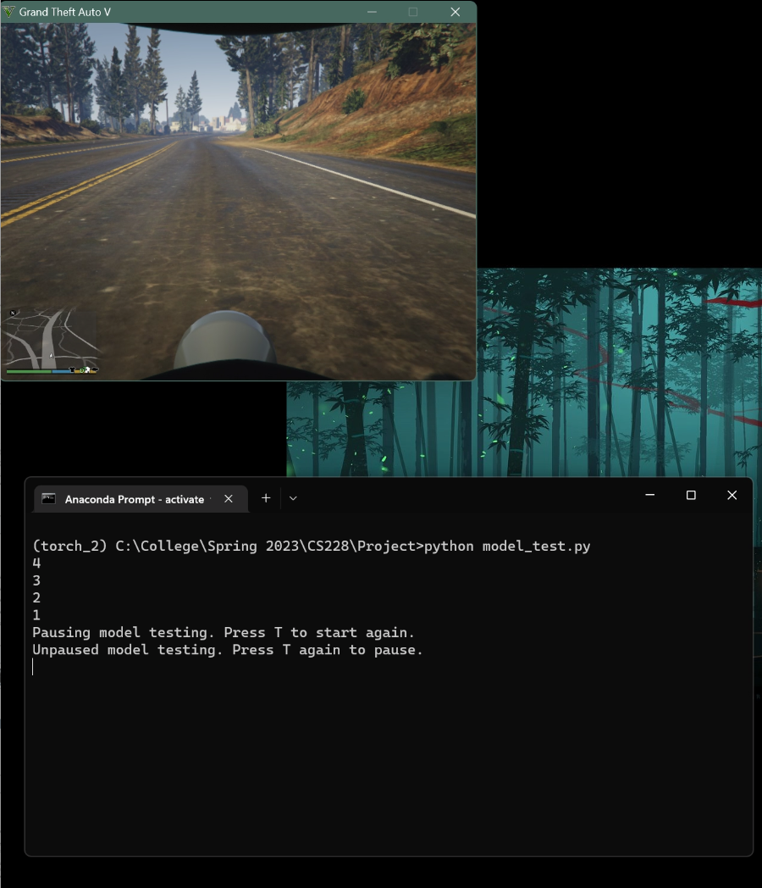

This demo is a run through from the highlighted route in the below map.
At the end of video

Slide 13
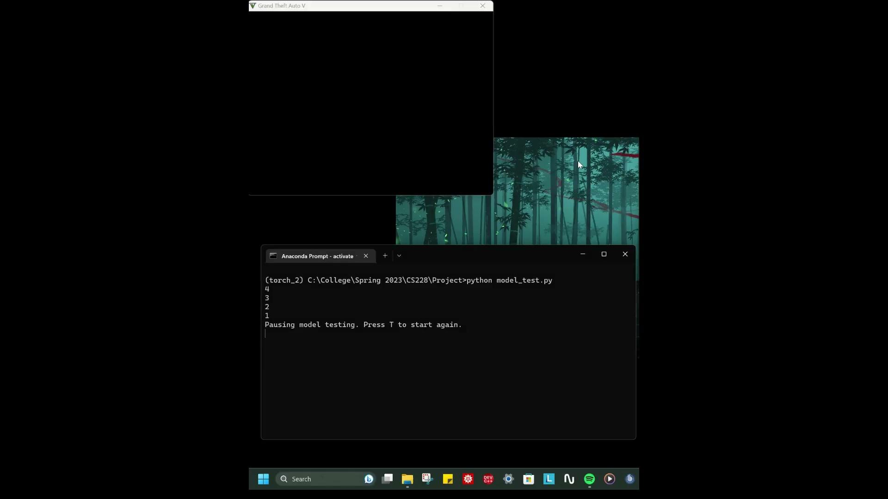

Slide 14
Experimental Results
Dataset size (~1k) | Final Training Accuracy | Final Test Accuracy
45 | 81.6 | 78.6
60 | 93.5 | 85.2
83 | 94.8 | 87.1
95 | 92.6 | 85.8
115 | 93.4 | 86.24
Metrics calculated on five different instances of models and dataset sizes

Slide 15
Future Work
Explore the use of transformer models for autonomous driving in virtual environments.
Further improve attention mechanisms to enhance the model's ability to focus on relevant information.
Utilize reinforcement learning techniques to enhance the model's decision-making capabilities.Train the model to make optimal driving decisions based on rewards and penalties.
Optimize the model's architecture and algorithms for faster inference and decision-making.
Enhance the model's perception of complex scenarios in virtual environments.Explore techniques for better object detection, tracking, and understanding of dynamic environments.
Address real-time constraints to ensure efficient gameplay and responsiveness.

Slide 16
Conclusion
Deep learning models, such as InceptionV3, have significant potential for autonomous driving in virtual environments.
Continuously improving attention mechanisms and exploring new techniques will contribute to highly capable and intelligent autonomous driving systems in GTA 5.
The findings from this project have practical applications and can advance research in the field of virtual autonomous vehicles.

